Slide 1
Using Social Media to Enhance Medical Education: Education Excellence Workshop
Judith (Judy) Gadde, DO, MBA
Associate Professor of Radiology & Medical Education
Northwestern University Feinberg School of Medicine
Director of Academic Innovation, Medical Imaging
Lurie Children’s Hospital of Chicago
@judygadde (X)
Notes:
20 mins

Slide 2
Disclosures
None
@judygadde

Slide 3
Outline
X, formerly known as Twitter
BookWidgets
@judygadde

Slide 4
Learning Objectives
Describe how to use social media professionally.
Identify opportunities for creating interactive exercises and self-assessments.
@judygadde

Slide 5
X, Formerly known as Twitter

Slide 6
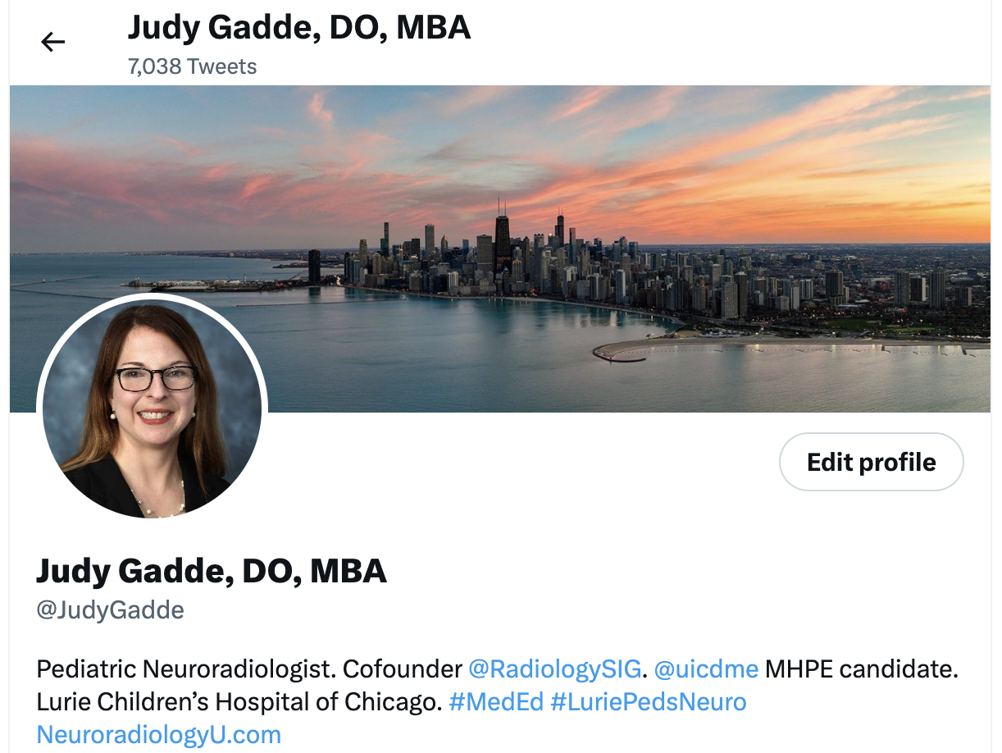
Twitter – Create a Profile
Banner Photo
Profile Photo
Handle/Display Name
Bio
@judygadde

Slide 7
INTERESTING CASES

Slide 9
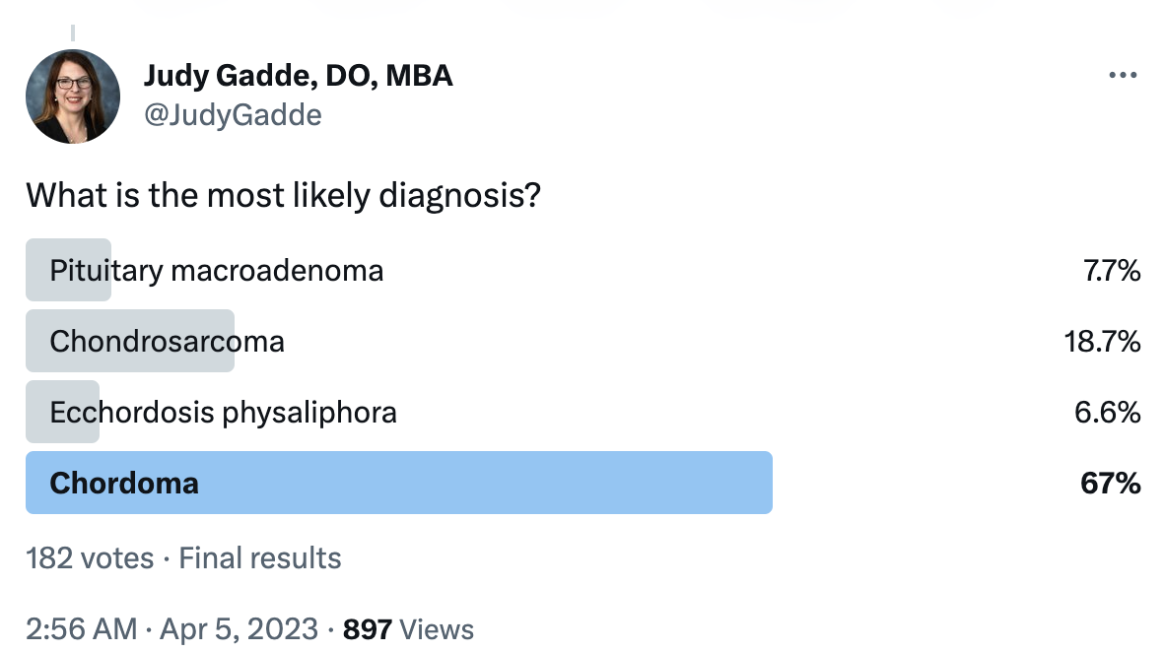
@judygadde

Slide 10
@judygadde

Slide 11
BookWidgets

Slide 12
BookWidgets Info
30-day free trial
https://www.bookwidgets.com/a/signup?redirect_to=%2Fa%2Fhome%3Fstart-trial%3D1
Pricing info
https://www.bookwidgets.com/pricing
@judygadde

Slide 13
BookWidgets
@judygadde

Slide 14
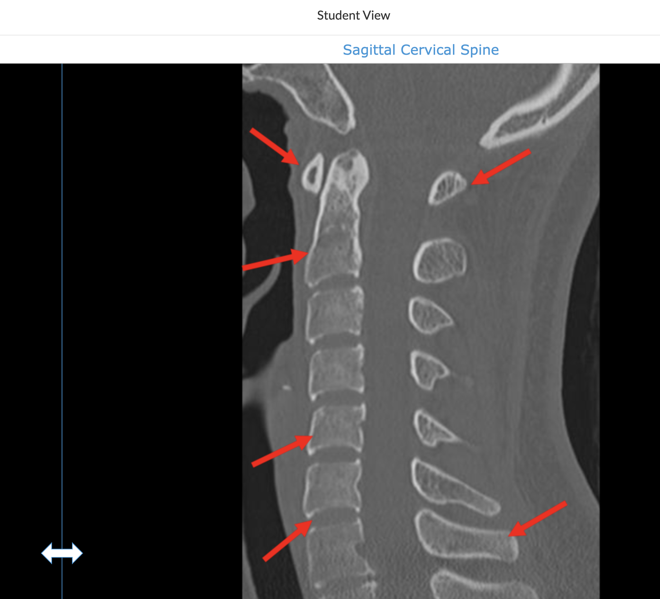
@judygadde

Slide 15
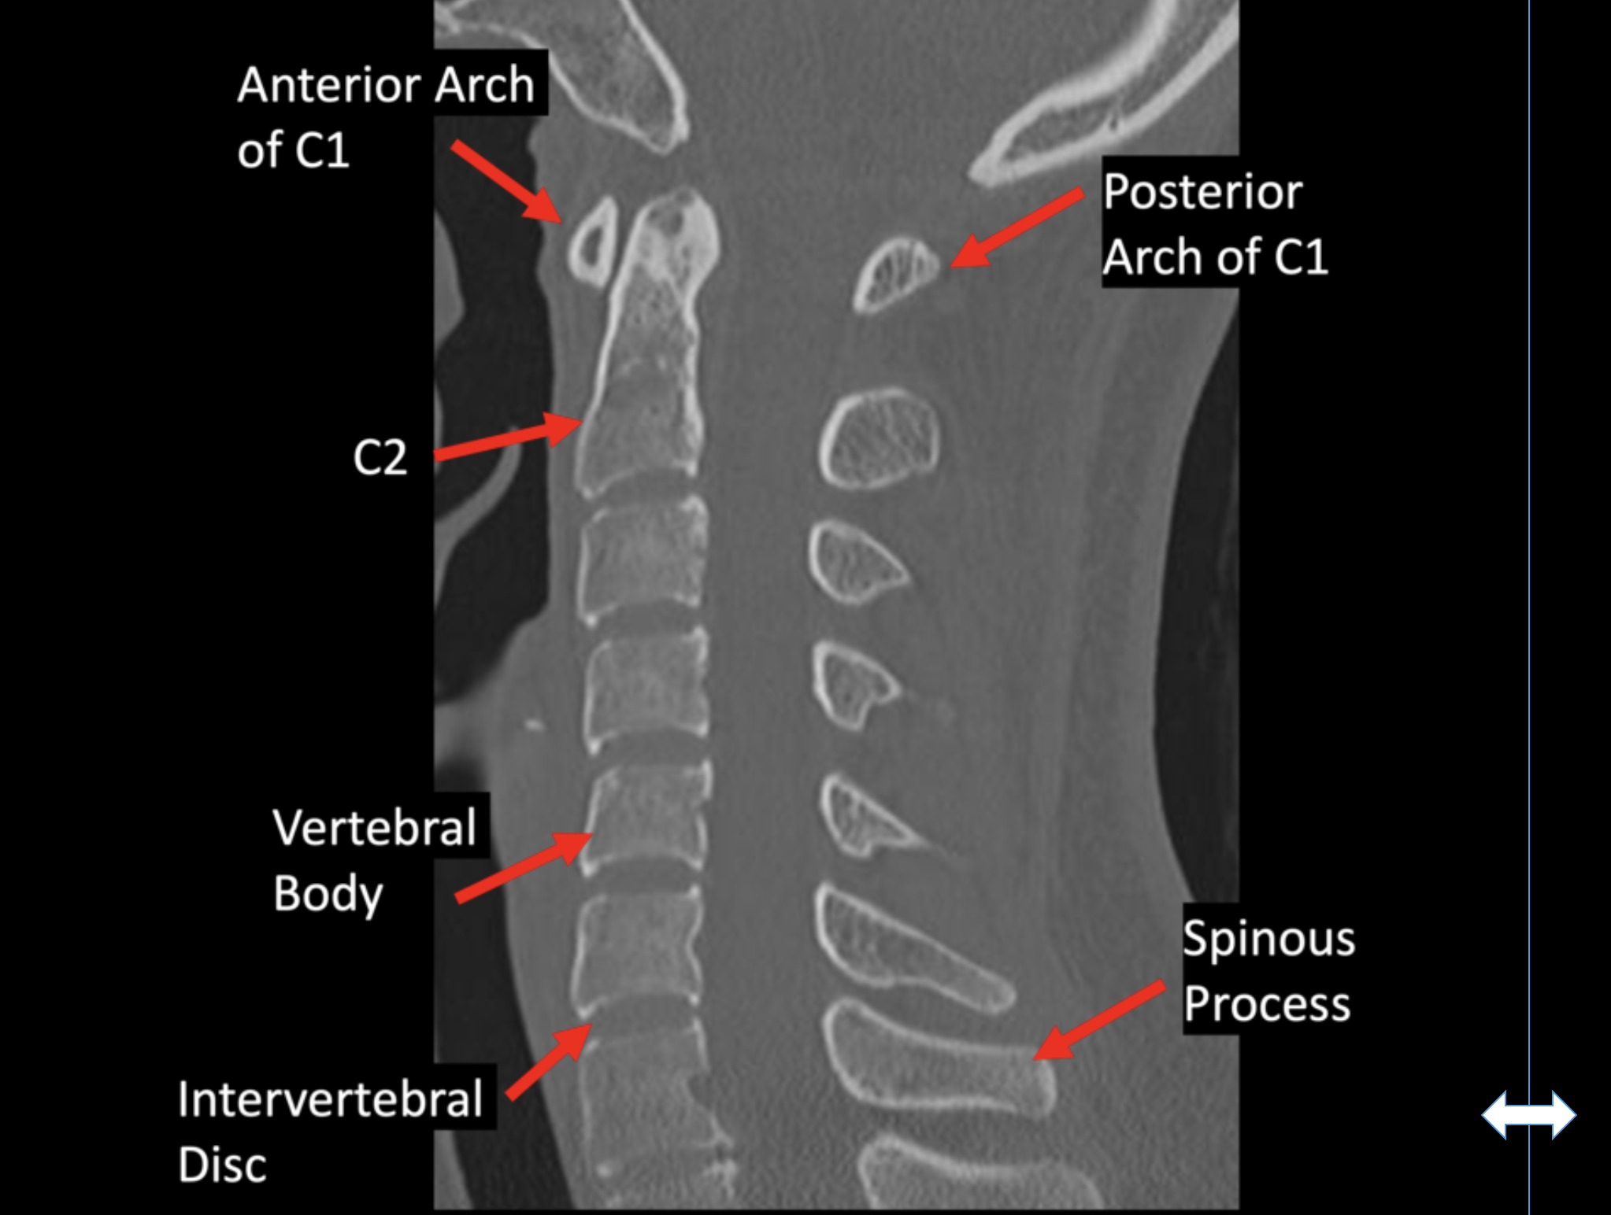
@judygadde

Slide 16
Summary
Social media has many potential professional benefits, including promotion of medical education and each other.
Different social media platforms can be used for various professional purposes.
@judygadde

Slide 17
Thank You
jgadde@luriechildrens.org
judygadde@gmail.com
@judygadde (X)
@drjudygadde (IG)

